Slide 1

Note: The data and information in this document is reflective of a hypothetical situation and client. This document is to be used for KPMG Virtual Internship purposes only.
Sprocket Central Pty Ltd
Data analytics approach
Sahil Singasane (KKPMG Virtual Internship

Slide 2
Note: The data and information in this document is reflective of a hypothetical situation and client. This document is to be used for KPMG Virtual Internship purposes only.
Agenda
Introduction
Data Exploration
Model Development
Interpretation

Slide 3
Note: The data and information in this document is reflective of a hypothetical situation and client. This document is to be used for KPMG Virtual Internship purposes only.
Introduction
New Customers Analysis
Analyze the following factors for new customers:
Age distribution criteria
Gender
Bike Purchase in 3 years
Job Industry Category
Car owns by the new customer
Wealth Distribution

Slide 4
Note: The data and information in this document is reflective of a hypothetical situation and client. This document is to be used for KPMG Virtual Internship purposes only.
Data Exploration : Age Distribution & Bike Purchases
Customers are more from the age group of 40s , followed by 50s & 60s.
Fewer customer are from 10-19 & 80-99 for obvious reasons.
Data shows age group 40-50 and 50-60 have high count in terms of bike related purchases in last 3 years with a slightly greater female ratio.
The target audience for our marketing and advertising should be inclined on females than males.

Slide 5
Note: The data and information in this document is reflective of a hypothetical situation and client. This document is to be used for KPMG Virtual Internship purposes only.
Data Exploration : Job Industry
• Financial Services, Manufacturing, and Health are the top three profit generating industries, followed by retail and property.

Slide 6
Note: The data and information in this document is reflective of a hypothetical situation and client. This document is to be used for KPMG Virtual Internship purposes only.
Data Exploration : State
New south wales has the highest number of bike purchases amongst the three states

Slide 7
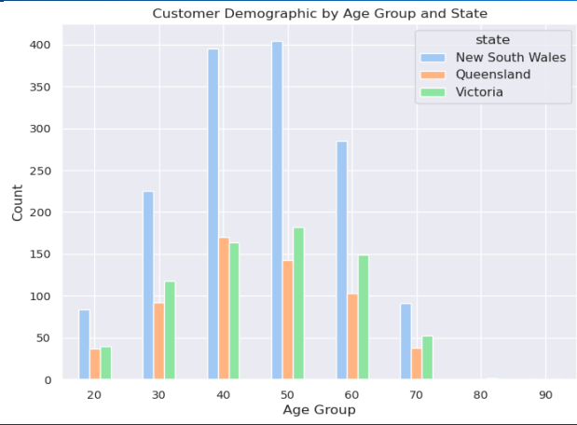
Note: The data and information in this document is reflective of a hypothetical situation and client. This document is to be used for KPMG Virtual Internship purposes only.
Data Exploration : Customers
It is evident that New south wales has the highest number of customers across all the age groups.

Slide 8
Note: The data and information in this document is reflective of a hypothetical situation and client. This document is to be used for KPMG Virtual Internship purposes only.
Data Exploration : Wealth
Customers in the wealth segment of Mass are the majority with females edging the males.
Affluent customers and High net worth customers have almost similar numbers

Slide 9
Note: The data and information in this document is reflective of a hypothetical situation and client. This document is to be used for KPMG Virtual Internship purposes only.
Model Development
CUSTOMER CLASSIFICATION – Targeting High Value Customers
The following are the high-value clients to target :
• Aged between 40 – 60.
• Most of the high value customers are female compared to male.
• Working in Financial Service, Manufacturing and Health.
• Who are currently living in New South Wales and Victoria.
• Wealth with the focus on mass customers

Slide 10
Note: The data and information in this document is reflective of a hypothetical situation and client. This document is to be used for KPMG Virtual Internship purposes only.
THANK YOU

